Slide 1
Card Counting BlackJack
REINFORCEMENT LEARNING AND DYNAMIC OPTIMIZATION
Presented by:
Lamprakis Michalis
Elia Dimitris
Prof:
Spyropoulos Thrasyvoulos

Slide 2
ENVIRONMENT
Phase 1
Phase 2
We implemented our own custom Blackjack environment in Python with the help of ChatGPT.
For Phase 1, the environment was built to simulate the rules of simplified Blackjack with only HIT/STICK decisions, without Betting.
For Phase 2, we added Double Down action, betting option and 3/2 Blackjack (natural Blackjack).

Slide 3
PHASE 1
Algorithm
Tabular Q-Learning
Training Parameters
Alpha: 0.01 (We started with a = 0.1 but with 0.01 the training is more stable)
Gamma: 1.0
Epsilon: decayed linearly from 1 to 0.05 across 100,000 episodes
Deck Reshuffle
When remain less than 10 cards
State Space
Task 1
(player total, dealer upcard, usable ace)
Task 2
(player total, dealer upcard, usable ace, hi-lo bucket)
High state: running count>3
Low state: running count <-3

Slide 4
PHASE 1:PERFORMANCE
Task 1
Task 2
500.000 episodes for training
100.000 episodes for evaluation
Win: 42% , Lose: 48% , Draw: 9%.
With 1$ bet we lose 6 cents per game.
Compared to basic Strategy: 95-96% Compliance
1.500.00 episodes for training
100.000 episodes for evaluation
Win rate +0.5% but not stable.

Slide 5
PHASE 2: TASK 1
Environment:
Fixed bet 1$ at the start of each round with the option to Double Down.
Natural Blackjack pays 1.5 times the bet.
State space:
(player total, dealer upcard, usable ace, can_double)
(player total, dealer upcard, usable ace, can_double,hi_lo_bucket) for the hi-lo environment
Training Parameters:
Alpha: decayed linearly from 0.1 to 0.01 across 200,000 episodes
Gamma: 1.0
Epsilon: decayed linearly from 1 to 0.05 across 1M episodes
Training:
5,000,000 episodes
Evaluation:
100,000 episodes
Best Strategy Compliance:
96%

Slide 6
PHASE 2: TASK 1 PERFORMANCE
Basic Agent
Hi-Lo Agent
Average profit per game: -0.02$
Average bet size: 1.00$
Double-down rate: 1.36% of games
Double-down win rate: 64.75%
Win: 43.25% Draw: 9.13% Lose: 47.62%
Average profit per game: -0.01$
Average bet size: 1.00$
Double-down rate: 2.37% of games
Double-down win rate: 59.53%
Win: 43.74% Draw: 8.72% Lose: 47.55%

Slide 7
PHASE 2: TASK 2
Algorithm and model details
We implemented a Deep Q-Network (DQN) agent for playing policy and a separate neural network for betting (called BetNet).
Play policy (DQN)
Input state: (player total, dealer upcard, usable ace, can double, true count)
Output: Q-values for HIT (0), STICK (1), DOUBLE (2)
Architecture: Input(5) → 128 → ReLU → 64 → ReLU → Output(3)
Hyperparameters:
Alpha: 1e-4
Gamma: 1.0
Epsilon: decayed linearly from 1.0 to 0.05 across 1M episodes
Replay buffer: 200,000 transitions
Batch size: 128
Target network update: every 5,000 steps
Betting policy (BetNet)
Input: true count
Output: Distribution over 10 discrete bet sizes ($1–$10)
Architecture: Input(1) → 64 → ReLU → 32 → ReLU → Output(10)
Training: reward = game outcome + bonus if betting aligned with true count
Hyperparameters:
Alpha: 1e-4
Gamma: 1.0
Epsilon: decayed linearly from 1.0 to 0.05 across 1M episodes
Replay buffer: 200,000 transitions
Batch size: 128
Target network update: every 5,000 steps

Slide 8
PHASE 2: TASK 2 PERFORMANCE
1 Deck
4 Decks
Average profit per game: 0.09$
Average bet size: 5.13$
Expected return per unit bet: 0.0182
Double-down rate: 8.79%
Double-down win rate: 55.73%
Win: 44.00% Draw: 8.27% Lose: 47.73%
Average profit per game: 0.01$
Average bet size: 4.64$
Expected return per unit bet: 0.0024
Double-down rate: 8.34%
Double-down win rate: 54.51%
Win: 43.58% Draw 8.24% Loss 48.18%

Slide 9
COMMENTS
We achieve a positive expected return per unit bet, which means the agent is statistically profitable — effectively beating the casino under these settings.
Without betting the DQN policy would be almost the same as Task1
Betting Policy – The Key Innovation
BetNet takes the true count as input and learns to scale bets intelligently:
Bets $8–$10 when the count is high (good odds)
Bets $1–$2 when the count is neutral or low
This means the agent bets more when the deck is favorable, just like a real card counter.
Combined with a stable play policy, this leads to profit.
The more decks in play, the less accurate the count becomes, and the less powerful card counting is.

Slide 10
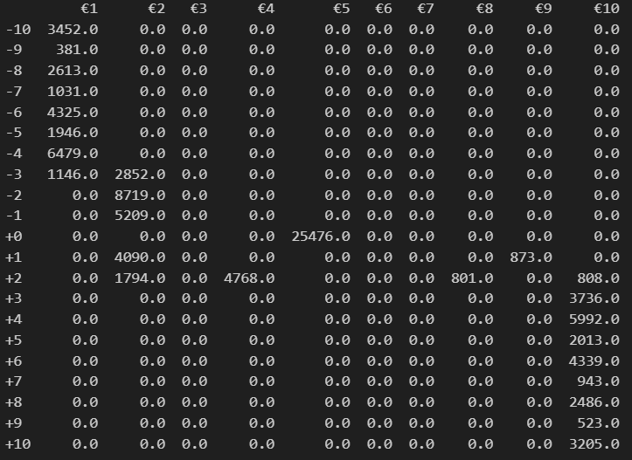
BET TABLE

Slide 11

Thank you

